Slide 1
LGE Internal Use Only
Project Communication
Objective
Common Validation Project Organization
Internal communication: DCV leader – DCV members
External communication: DCV-HQ/OEM
Q&As
2020.8.13
VS DCV

Slide 2
I. Objectives
Objectives
Understand common organization for Validation project (project parts HQ-DCV-Vendor, members, R&R) and communication methods
Understand how to effectively communicate internally (btw DCV project members) and externally (DCV-HQ/OEM)
History
Version | Date | Comment | Author/Reviewer
v1.0 | 2020/08/07 | Create first version | Tuoi.Pham

Slide 3
I. Common Validation Project Organization
Type 1
Type 4
Vietnam Test Team
HQ Test Team
Vietnam Test Team
HQ Test Team
DCV Test Leader
HQ TM
DCV Test Leader
HQ TM
<Project Name>
<Project Name>
DCV Member 1
HQ Member 1
DCV Member 1
Vendor Member 1
DM
<Function in charged>
<Function in charged>
<Function in charged>
HQ Member 1
DCV Member n
HQ Member n
DCV Member n
Vendor Member n
HQ Member n
<Function in charged>
<Function in charged>
<Function in charged>
1/16

Slide 4
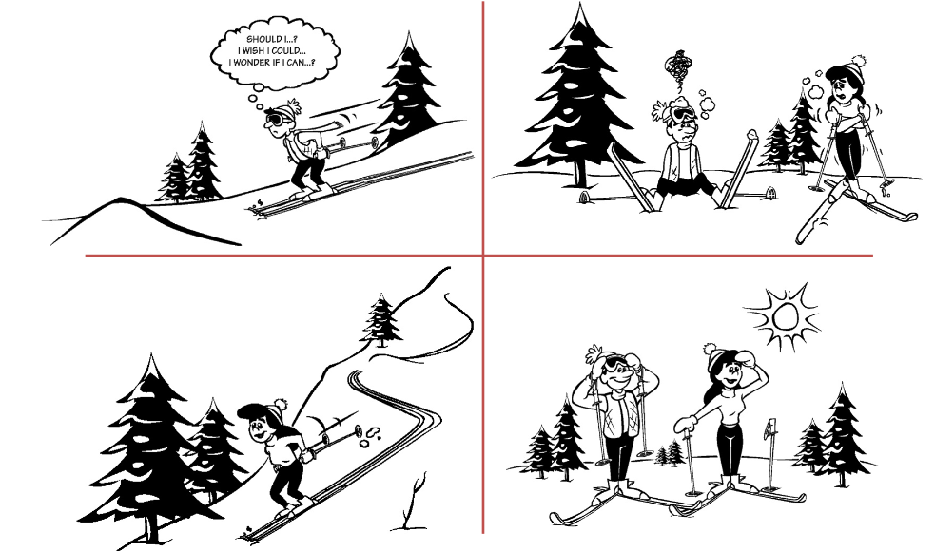
Let’s Get Situational
2/16

Slide 5

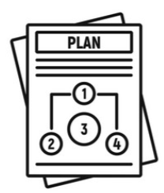
II. Internal communication: Formal Working Interaction
DCV Leader
DCV Member
DCV Leaders should assign tasks & interact with team members differently depending on their development (professional maturity) level.
Development Level
(Professional Maturity)
Competence
(Knowledge, Skills)
Commitment
(Confidence, Motivation)
=
x
Level D1
Interested in new challenges and ready to learn new things, but has very little competence.
Level D2
Finds work more difficult than expected and progress is slow.
Skill level is not high enough to achieve goals.
Level D3
Able to produce outputs as required, but commitment levels vary.
Has little confidence if he/she could do well in new circumstances.
Level D4
Has enough competence to do jobs alone.
Has high level of confidence and motivation.
3/16
Notes:
What is difference btw knowledge and skill
Knowledge is information acquired through sensory input: Reading, watching, listening, touching, etc. The concept of knowledge refers to familiarity with factual information and theoretical concepts. Knowledge can be transferred from one person to another or it can be self acquired through observation and study.
Skills, however, refer to the ability to apply knowledge to specific situations. Skills are developed through practice, through a combination of sensory input and output. As an example, social skills are developed through interaction with people by observing, listening, and speaking with them. Trial and error is probably the best way to achieve skills mastery.

Slide 6
II. Internal communication: Leadership Styles
Listen by building up trust and facilitate to solve problems.
Improve members’ passion and motivation by asking how jobs to be done.
Have members reach solutions themselves.
Focus on asking and listening in order for members to decide with their own ideas and methods.
S3
Supporting
S2
Selling
Use directive and supportive behaviors in a balanced way.
Listen to members’ opinions and request information for decision-making, but final decision is made by leader.
Set goals and implementation plans by asking for members’ opinions and ideas.
Maintain influence on “WHAT” and “HOW”
Low direction and low support don’t mean no direction and no support. Members should be informed of work progress and outputs.
Provide “WHAT” continuously but no “HOW”.
Leader delegates responsibility and authority, but set goals and evaluate members’ performance results.
Leader continually delegates new tasks and align members’ behaviors to the organizations’ goals.
S4
Delegating
S1
Telling
Decide what, when, with whom members to do.
Provide solutions.
One-way communication with thorough monitoring.
Don’t request information for decision-making from members.
It is important to use “what” and “how” adequately. It embarrasses members only by checking deadline and action plans. Without using “how”, it will look S4 Delegating style.
Lowy, Alex. and Hood, Phil. The Power of the 2X2 Matrix, New Jersey : Jossey-Bass Business & Management, 2004.
(Originally from Hersey, P. The Situational Leader, New York : Warner Books. 1992.)
4/16

Slide 7
II. Internal communication: Development Levels & Leadership Styles
(H)
Low Direction
and
High Support
High Direction
and
High Support
S3
S2
Supportive Behavior
S4
S1
Low Direction
and
Low Support
High Direction
and
Low Support
(L)
(H)
Directive Behavior
Directive Behavior
D4
D3
D2
D1
Developed
Follower’s Development Level
Developing
Lowy, Alex. and Hood, Phil. The Power of the 2X2 Matrix, New Jersey : Jossey-Bass Business & Management, 2004.
(Originally from Hersey, P. The Situational Leader, New York : Warner Books. 1992.)
5/16

Slide 8
II. Internal communication: Development Levels & Leadership Styles
COMPETENCE
COMMITMENT
Knowledge
Skills
Motivation
Confidence
DL
SL
D4
S4
High
D3/4
S3/4
Low
D3/4
S3/4
High
High
D3
S3
Low
Low
D3/2
S3/2
High
High
D3/2
S3/2
High
Low
D2/3
S2/3
High
High
D2
S2
Low
Low
Low
High
D1/2
S1/2
Low
High
High
D1/2
S1/2
Low
Low
High
D2/1
S2/1
Low
D2
S2
High
Low
High
D1
S1
Low
D1/2
S1/2
Low
High
D2/1
S2/1
Low
D2
S2
6/16

Slide 9


II. Internal communication: Informal Working Interaction
DCV Leader
DCV Member
DCV Leaders should Listen to DCV members
by Understand and Empathy ability
to go to the same destination
7/16
Notes:
Question:
Guess what are informal interactions?
3 words for interactions: 1 verb and 2 nouns (LUE)

Slide 10


II. Internal communication: Leader’s good signals
Positive
Thinking
Possible Goal
Positive Personal
Characteristics
Vision-Mission
View
Humourist
Clear Expectation
Failure
Member
Relationship
Excellent
Communicator
Power
Delegation
Public Praise
Private
Complaint
Leadership
Skill
Good
Supporter
Motivation
Skill
Member is #1
Good
Supporter
High Reliability
Recognize
outstanding efforts
Lead & Inspire
Consistent Behaviour
Reliable Voice
8/16
Notes:
Questions:
Which are characteristics/skill can apply for Formal Interactions
Which are characteristics/skill can apply for Informal Interactions

Slide 11

II. Internal communication: Case Study
Tips: Combine btw Formal and Informal communication methods to define how to communicate with member best
Case
CASE 1: HOW TO MANAGE OLDER & YOUNGER PEOPLE
Project A just got award from 3 months ago and project organization has been established for one and a half month. Detailed:
Project size: 7 members (1 test leader, 3 seniors, 2 junior and 1 fresher)
Test leader role: assign task to all members, manage project (human, progress, performance and quality)
Note:
All members (except fresher) worked together more than 1.5 years and moved from old project
Test leader is new, just promoted to be test leader for this project and is younger than almost seniors
9/16

Slide 12
II. Internal communication: Case Study
Tips: Combine btw Formal and Informal communication methods to define how to communicate with member best
Case
CASE 2: HOW TO MANAGE/COMMUNICATE POOLING RESOURCES
Due to OEM A’s demand, company defined a pool including 25 members to serve AVN domain for this OEM. Currently this pool is working for 3 projects and three test leaders are allocated to manage each project and 1 part leader is allocated to manage all. This is common pool therefore members can be assigned flexibly depend of project situation.
Project 1: 10 members (include Test leader)
Project 2: 8 members (include Test leader)
Project 3: 6 members (include Test leader)
Project schedules: sometimes overlap, sometimes not, and all projects have the same start-end dates
➔ Assumption you are test leaders and part leader for this pool, how you can assign tasks effectively, evaluate fairly and develop resources stably?
10/16

Slide 13
II. Internal communication: Case Study
Tips: Refer to Development Levels & Leadership Styles to define how to keep balance communication way
Case
CASE 3: RESERVED COMMUNICATION DIRECTION (WITH HIGHER MANAGER)
My new manager is working for company more than 10 years, he has much management skill and often direct us what he wants. I’m a sub-leader and my working style is perfect orientation, always investigate assignment to do best and frequently raise questions as well as raise my idea to my manager. After 6 months, I feel that I contributed well and did good job but when 1:1 with my manager he said that I need to improve much because I did not follow his direction correctly. So, could you help me how to do next step?
11/16

Slide 14
III. External communication: Case Study
CASE 1: PERFORMANCE AGREEMENT
Dear Ms. A,
My boss, Mr. P, he sent reference data from the closed project (similar to our project: the same domain and the same testing type) and shown that their productivity is double compared to our current productivity, therefore he strongly requested that we need to increase our productivity equally. Please find the way and start applying this target from the next testing round.
Here is detailed information:
….
Regards,
John
➔ Please discuss with your team to negotiate this
12/16

Slide 15
III. External communication: Case Study (Cont.)
CASE 2: RESOURCE MGMT AGREEMENT
Your project is Type4, named OEM_version2.0, almost project members already joined the previous project (OEM_version1.0, closed by end of last year). Last year, HQ sent VOE that project resource was not stable due to vendor’s resignation and DCV maternity leave.
Recently Covid situation has been happened, more and more complex and impacted much to business and this directly impacts to your project. HQ TM sent request to reduce 2 DCV members and 3 vendor members from next month. You are Test Leader, please forecast risk impact and make plan how to negotiate with HQ to have the best solution (new MM, Handover task, Scope, Deadline…)
Here is your original plan of resource MM :
Project resource situation:
DCV has 10 members in which 2 pregnant members, one will take maternity leave (ML) from 7-Sep-20 and the remaining one will take ML from 5-Oct-20
Current tasks: updating TCs until 16-Oct (based on the latest REQ if any) and continue execution test (~6900TCs)
We are here
Project | Period | DCV / Vendor | 2020 |  |  |  |  |  |  |  |  |  |  |  | 2021
 |  |  | 1 | 2 | 3 | 4 | 5 | 6 | 7 | 8 | 9 | 10 | 11 | 12 | 1 | 2 | 3
A | 2020.1~2021.3 | DCV | 10 | 10 | 10 | 10 | 10 | 10 | 10 | 10 | 10 | 10 | 10 | 10 | 10 | 10 | 10
 |  | Vendor TC Engineer
 |  | Vendor TE Engineer |  |  |  | 15 | 15 | 15 | 15 | 15 | 15 | 15 | 15 | 15 | 15 | 15 | 15
 |  | Vendor Total |  |  |  | 15 | 15 | 15 | 15 | 15 | 15 | 15 | 15 | 15 | 15 | 15 | 15
 |  | Total | 10 | 10 | 10 | 25 | 25 | 25 | 25 | 25 | 25 | 25 | 25 | 25 | 25 | 25 | 25
13/16

Slide 16
III. External communication: Case Study
CASE 3: INTERRUPT AGREEMENT
From CW32 to CW33 your project has to execute Full Validation test (FV9) with tired schedule. By the end of CW32, HQ TM sent request that need to verify 150 OEM defects fixed by Dev team and need to be completed within CW33. Please discuss and find the way to deal with this situation ☺
14/16

Slide 17


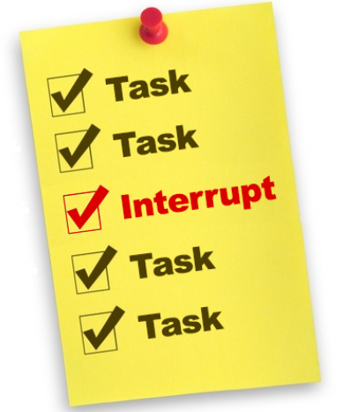



III. External communication: DCV-HQ
HQ TM/Vendor
DCV TL
NEGOTIATION
15/16

Slide 18

III. External communication: Negotiation Process
PREPARE
EXCHANGE
BARGAIN
CONCLUDE
EXECUTE
Building
Trusting Relationships
16/16
Notes:
https://www.watershedassociates.com/learning-center-item/negotiation-stages-introduction.html

Slide 19
Thank you
Q&As

Slide 20
Appendix: Negotiation Process - Prepare Stage
FIVE KEY ELEMENTS
DCV COMMON OUTPUTS
Key #1
Initial points to consider
Should I be negotiating?
What I need to know
Organize information
YES – I WILL NEGOTIATE ABOUT
Test Scope, Resource (MM)
Schedule (Deadline, FIT /FV Duration)
Performance (Productivity), Quality (TCs, Test Report)
Key #2
Research covers
Players and stakeholders
The fact base
Standards and benchmarks
Historical Data Reference and current data
Closed/Running projects: same domain, same OEM
Assumption from experts if new
Project Data
Key #3
Analysis includes
Re-organizing data
Anticipating what will happen
Assessing strengths and risks
Compared data, strong points and risks
Project data vs historical data/assumption data
Risks (E.g: new resources, new features, low s/w stability)
Strong points (E.g: much experience, automation support…)
Key #4
Identification of your and their
Interests
Positions: Goals, Most Desired Outcomes, Least Acceptable Agreements
Best Alternatives to a Negotiated Agreement
Concessions
Negotiation options (high-low priority)
Key #5
Know the relationship you want to build
Plan to build trust
Prepare for emotional reactions
Develop Probes to discover "Don't knows" and test Assumptions
Relationship options balance with negotiation options
New HQ/OEM: concentrate on building Trust (capability/willingness)
Old HQ/OEM: concentrate on maintaining relationship (improvement)
Notes:
Concession: nhượng bộ

Slide 21
Appendix: Negotiation Process – Exchange Stage
FOUR CRITICAL ASSESSMENTS
Trustworthiness – Are they honest and dependable?
Competency – Are they credible and able?
Likeability – Can you work well together?
Alignment of Interests – Are your interests aligned with theirs?
A Go/No-Go Decision Time in Exchange:
Positive negotiation: move forward. With trust developed, explore for creative solutions that address interests and see the potential to create real value
Negative negotiation process: make adjustments or implement the Best Alternative to a Negotiated Agreement (BATNA)
A list of forecasted situations for bargaining:
If the 1st negotiation option is not successful, move on the 2nd option
If the 2nd option is failed → move on the 3rd option
Notes:
Information Exchange: focus on building rapport and trust, without which neither party will feel comfortable sharing interests
Trustworthiness – Độ tin tưởng/tin cậy
Competency – Năng lực
Likeability – Khả năng thích ứng
Alignment of Interests – Cùng lợi ích, cùng quan điểm

Slide 22
Appendix: Negotiation Process – Bargain Stage
To be trusted, you must be generous ☺
Start “THANK YOU”
The 1st Bargain stage: show off how deeply investigate and concentrate on the common interests
Who did
How much spent time
Investigation result and “the best suggestion”
The 2nd Bargain stage: if not success in the 1st stage☺
Show off how much generous by overcoming the most difficulties and combining all we have
Send the second option
Break-time in failed case
The 3rd Bargain stage: show off the best of the best suggestion for the final negotiation
End “THANK YOU” – even failed

Slide 23

A Leadership Style Situation
Case
One of your members in a project team has dropped by to visit you at least three times in the last couple of weeks to discuss the issues of project management. He claims that the project is going well, but his frequent visit indicate to you that he lacks confidence. You know from independent sources that this project is progressing nicely. You should
A. Tell your member that he can handle the project, but periodically check to see how he is doing.
B. Give your member some specific guidelines for doing the project since you have managed a similar project in the past.
C. Listen to your member and try to reassure him that he can handle the project. Discuss alternative actions, but be careful not to make any decisions for him.
D. Give your member some specific ideas on how to complete the project, and listen to his reactions.
Notes:
https://quantrimang.com/neu-sep-cua-ban-co-17-dac-diem-nay-thi-hay-cong-hien-het-minh-vi-do-la-mot-ong-chu-rat-tuyet-voi-day-124048

Slide 24
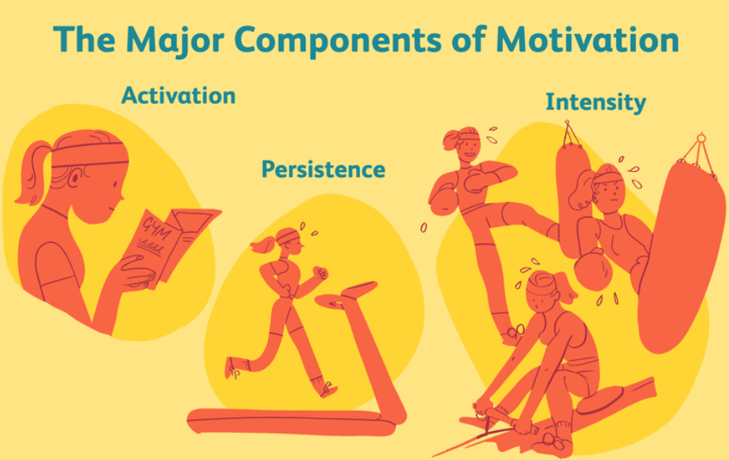
Appendix: Motivation Definition
Definition: Motivation is the process that initiates, guides, and maintains goal-oriented behaviours. It is what causes you to act, whether it is getting a glass of water to reduce thirst or reading a book to gain knowledge
Types of Motivation :
Extrinsic motivations are those that arise from outside of the individual and often involve rewards such as trophies, money, social recognition, or praise.
Intrinsic motivations are those that arise from within the individual, such as doing a complicated crossword puzzle purely for the personal gratification of solving a problem
2/16
Notes:
Activation: Chủ động
Persistence: Kiên trì
Intensity: Từng bước nâng cao cường độ

